Slide 1

Microsoft azure
By-Neha Dattatray Dawale

Slide 2
Contents
What is cloud computing
What is Azure
Microsoft Azure Architecture
Azure portal
What are the various Azure services
Why use Azure
SQL Azure
SQL Azure architecture

Slide 3
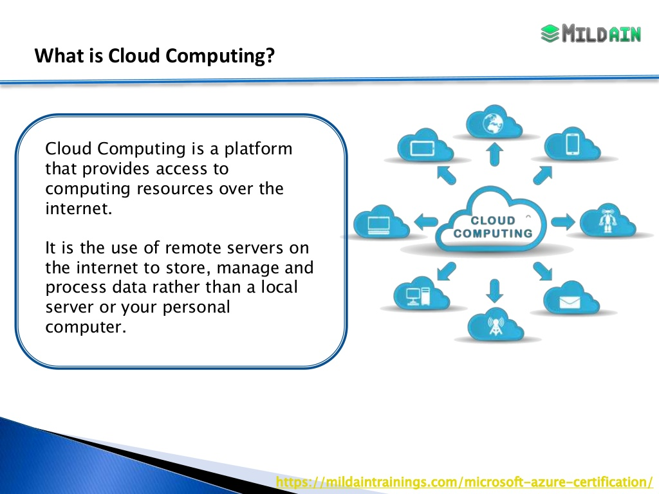
What is cloud computing?
Cloud computing is a term referred to storing and accessing of data over the internet. It doesn’t store any data on the hard disk of your personal computer.in cloud computing , you access data from a remote server.
Cloud computing can be used for various purposes:
Machine learning , data analysis , storage and backup , streaming media content and so much more.
All the shows and movies that you see on Netflix are actually stored in the cloud.

Slide 4
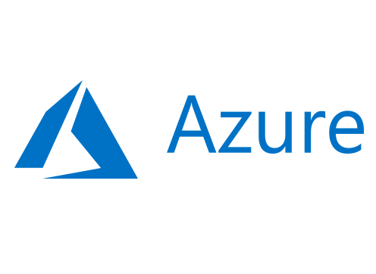
What is Azure?
Microsoft azure is cloud computing platform offered by Microsoft.
Microsoft azure offers various web scale and cloud services.
Microsoft offers various services across multiple domains such as compute , database , content delivery , networking and many more.
Azure cloud services are available in three different formats which include SaaS, PaaS, and IaaS.

Slide 5
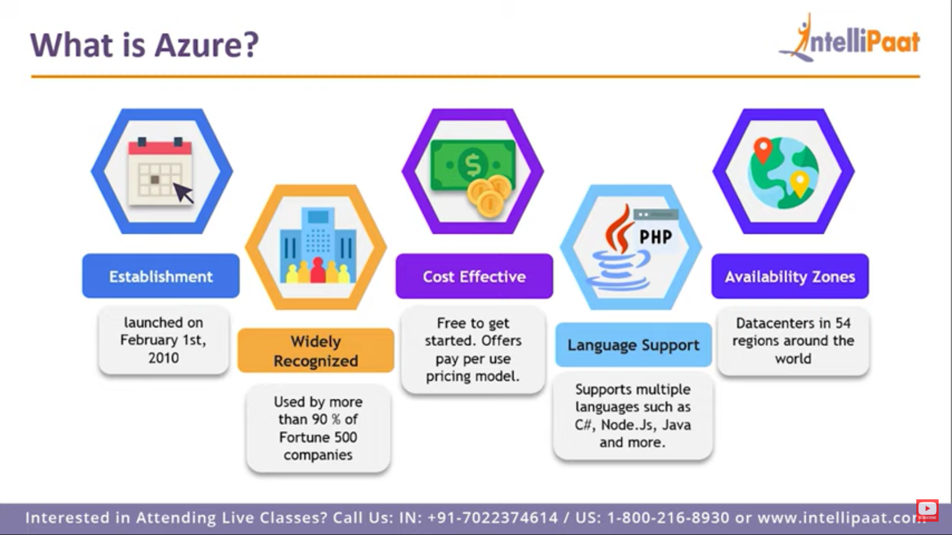

Slide 6
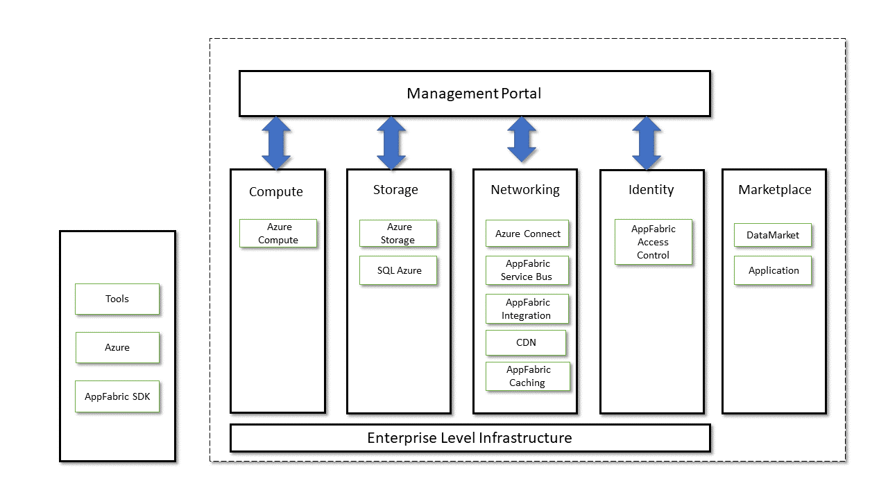
Microsoft Azure Architecture

Slide 7
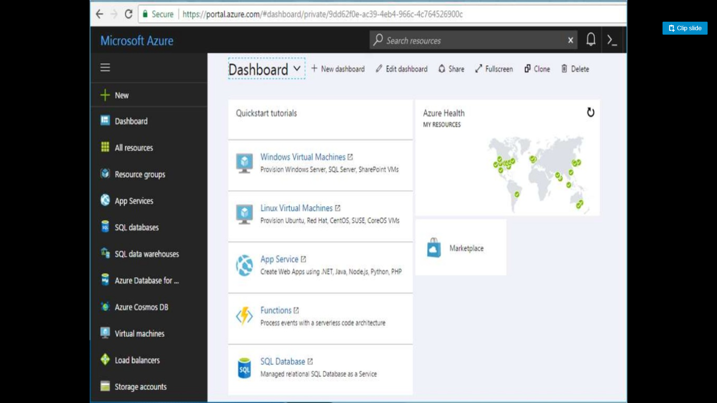
Azure Portal

Slide 8
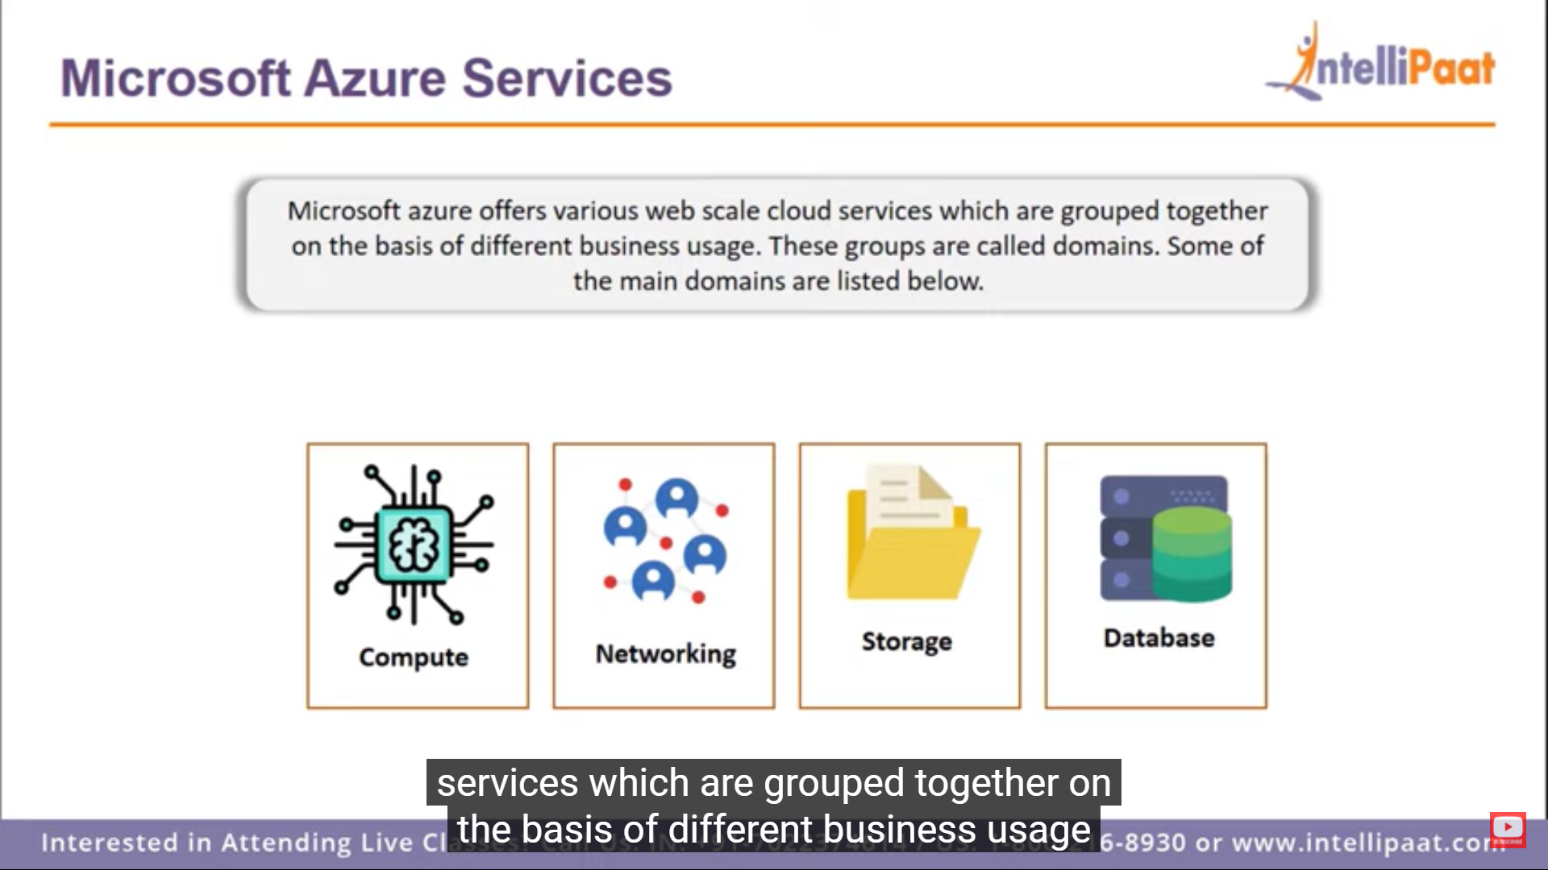
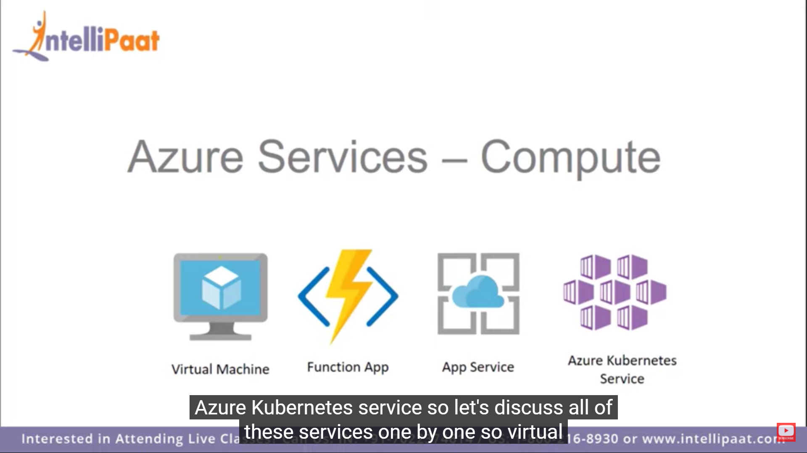
What are the various Microsoft Azure services
Microsoft azure Offers various web scale and cloud services which are grouped together on the basis of different business usage.
This grouped are called domains.
Compute Services-: If offers computing operations. Like app hosting , development and deployment in azure platform . It has the following components -:

Slide 9
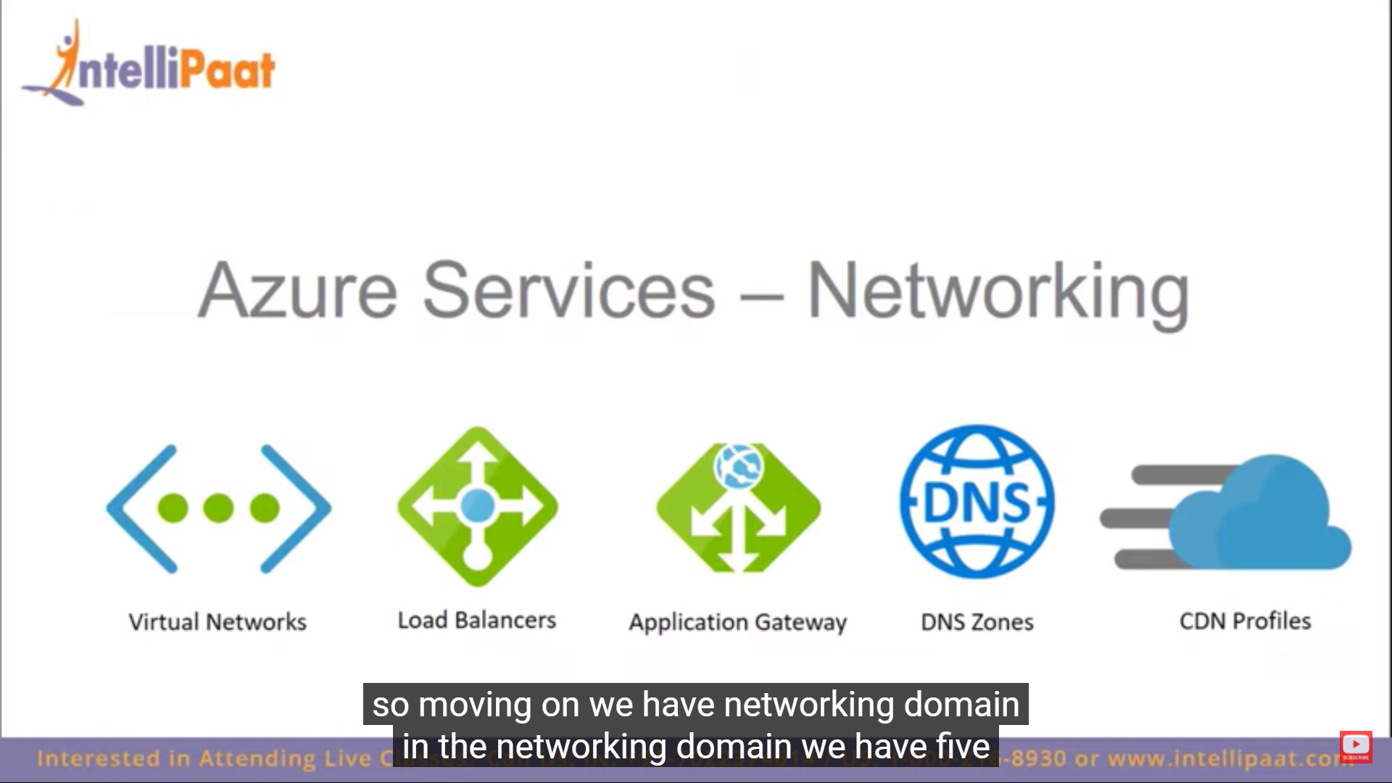
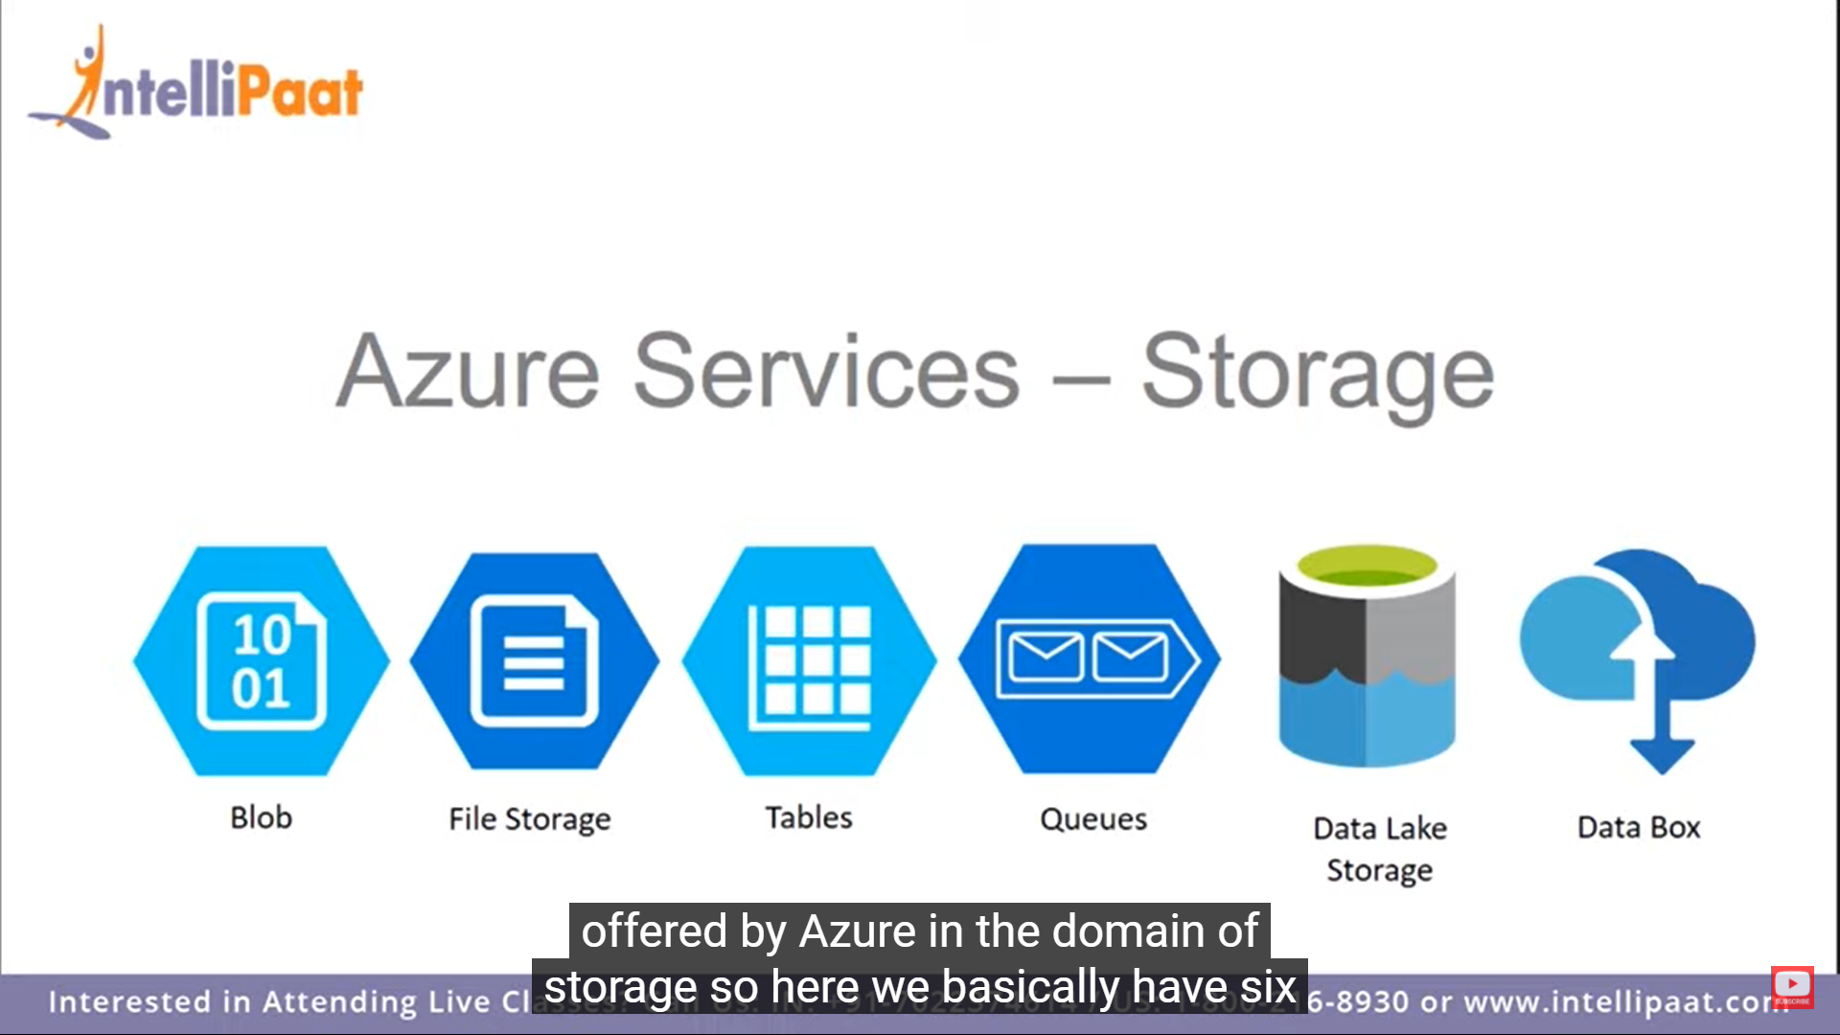
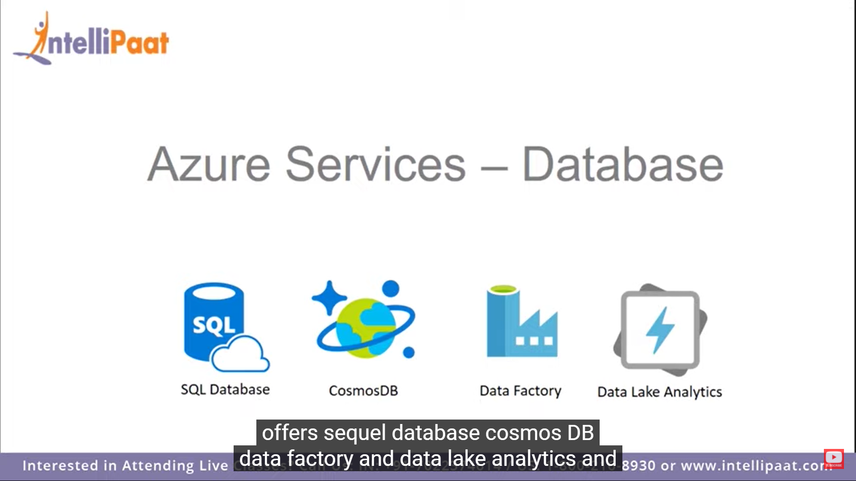
Networking service:
These networks allow enterprises to safely connect to their cloud resources through Azure ExpressRoute. It is also used to manage private virtual networks and, further, create multiple virtual networks.
Storage services: You can store and process hundreds of terabytes data.
Database: Microsoft azure database is a managed cloud database.

Slide 10
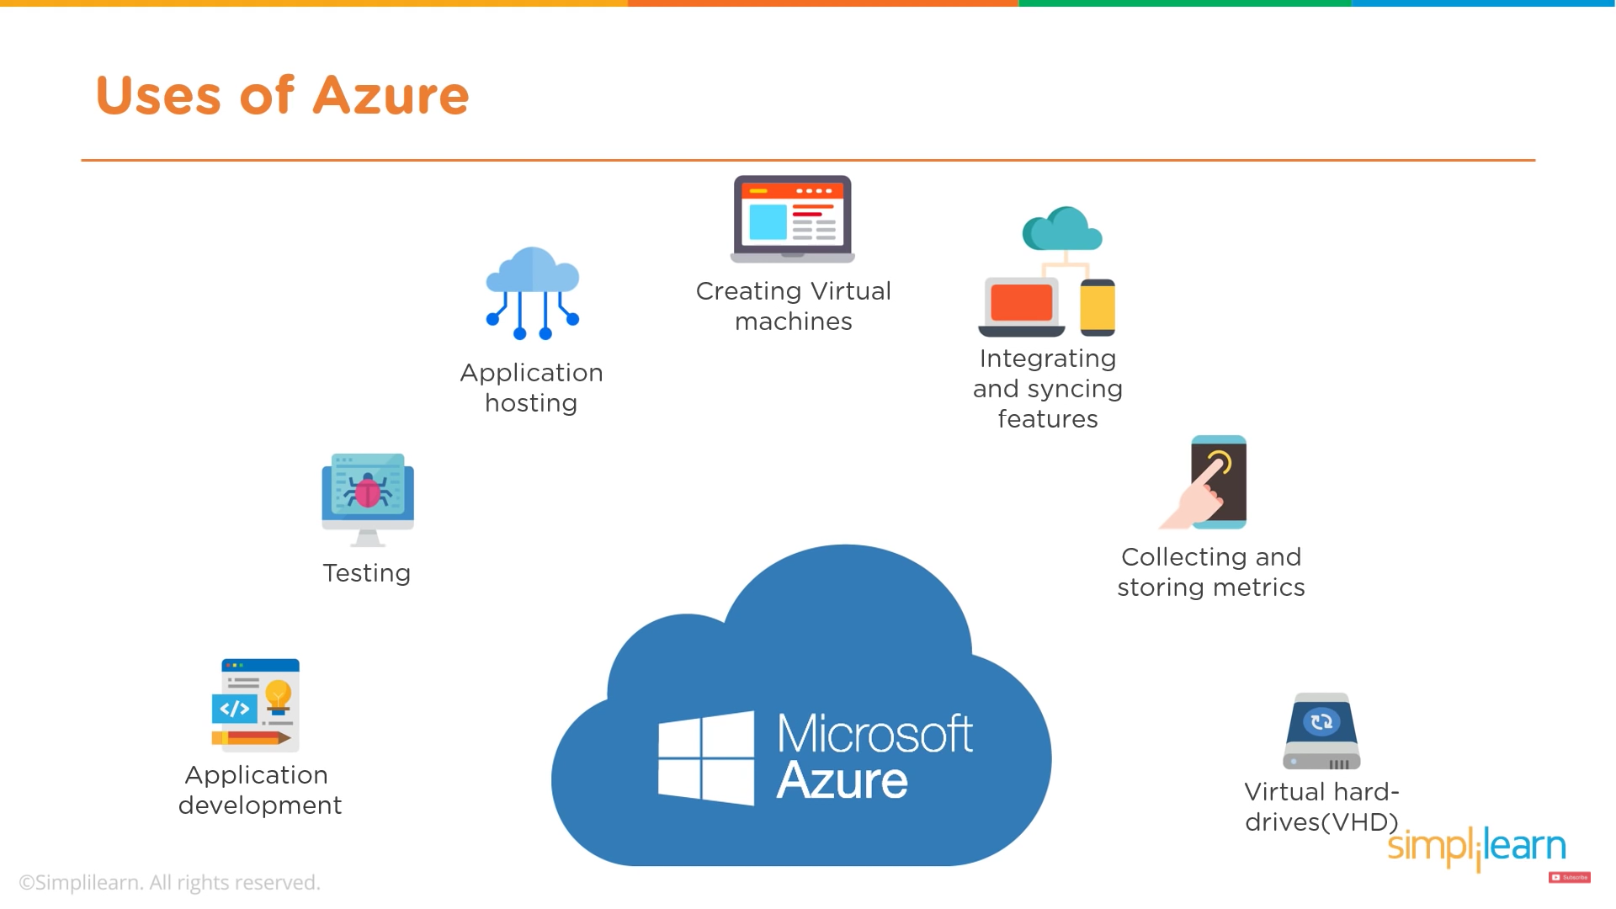
Why use Azure?
Application development
Testing
Application hosting
Create virtual machines
Integrate and sync features
Collect and store metrics
Virtual hard drives

Slide 11
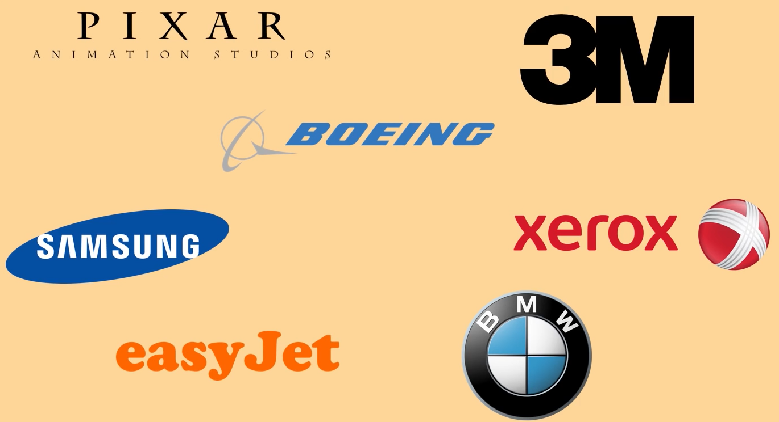
Companies that use Azure

Slide 12
SQL Azure
SQL azure is Microsoft database service
SQL server database technology and built on Microsoft ‘s windows azure cloud computing platform
SQL azure enables organizations to store relational data in the cloud and quickly scale the size of
It supports relational ,JSON, XML, and spatial data structures
Their databases up or down as business needs change.

Slide 13
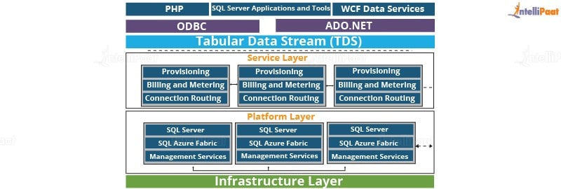
SQL Azure architecture
There are four layers in azure SQL azure architecture
Client layer
Service layer
Platform layer
Infrastructure layer

Slide 14
Thank You……….

